Slide 1
§2 Discrete-Time Signals In the Time-Domain
Outline
The time-domain representation of discrete-time signals
Operations on sequences
Classification of Sequences
Typical sequences
The Sampling Process

Slide 2
§2 Discrete-Time Signals In the Time-Domain
§ 2.3 Operations on Finite-length Sequences
前面定义的运算对有限长序列不适用：
A length-N sequences x[n], 0≤n≤N-1; its sample values are equal to zero for values of n < 0 and n ≥ N.
x[– n] is defined for the range –(N-1) ≤n≤ 0.
for any arbitrary integer n₀ , x₁[n] = x[n – n₀]
is no longer defined for the range 0≤n≤N-1.
必须定义有限长序列的运算，使得结果仍满足：
0 ≤ n ≤ N-1
MOOC

Slide 3
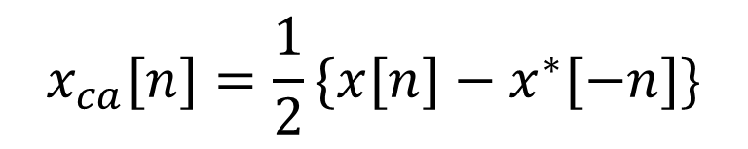
2.3.3 Classification of Sequences
1. Classification based on Symmetry
complex sequence x[n]
real y[n]
Conjugate-symmetry sequence
x*[n] = x[-n]
Even
y[n]=y[-n]
Conjugate-antisymmetry sequence
x*[n] = -x[-n]
Odd
y[n]=-y[-n]
Conjugate-symmetry part
Conjugate-antisymmetry part
$$x_{ca}[n]=\frac{1}{2}\{x[n]−x^{∗}[−n]\}$$

Slide 4
§2 Discrete-Time Signals and Systems
Example 2.8 A length-7 sequence(n:[-3,3]):
{g[n]} = {0, 1+j4, -2+j3, 4-j2, -5-j6, -j2, 3}
↑
{g﹡[n]}={0, 1-j4, -2-j3, 4+j2, -5+j6, j2, 3}
↑
{g﹡[-n]}={3, j2, -5+j6, 4+j2, -2-j3, 1-j4, 0}
↑
{gcs [n]}={1.5,0.5+j3,-3.5+j4.5,4,-3.5-j4.5,0.5-j3,1.5}
↑
{gca [n]}={-1.5,0.5+j,1.5-j1.5, -j2,-1.5-j1.5,-0.5+j,1.5}
↑

Slide 5
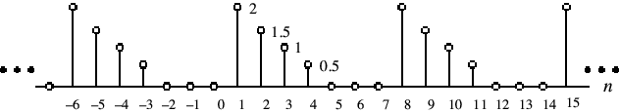
2.Classification of Sequences based on periodicity
§2 Discrete-Time Signals and Systems
A sequence satisfying the periodicity condition
is called an periodic sequence
for all n
Example
MOOC

Slide 6
§2 Discrete-Time Signals and Systems
fundamental periods
Adding two periodic sequences with different fundamental periods
The fundamental period：
LCM( )---least common multiple
MOOC
GCD( )---greatest common divider

Slide 7
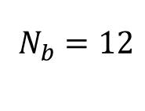
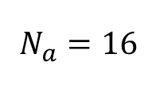
§2 Discrete-Time Signals and Systems
Example
$\overset{}{N_{a}=16}$=
$\overset{}{N_{b}=12}$=
Its fundamental period is 48,
because the GCD of 16 and 12 is 4.
MOOC

Slide 8
3. Energy and Power Signals
§2 Discrete-Time Signals and Systems
Total energy of a sequence x[n] is defined by
The average power of a sequence is defined by

Slide 9
§2 Discrete-Time Signals and Systems
Power signal: an infinite energy signal with finite average power.
Example - Power signal:
Note: x[n] has infinite energy
Its average power is given by

Slide 10

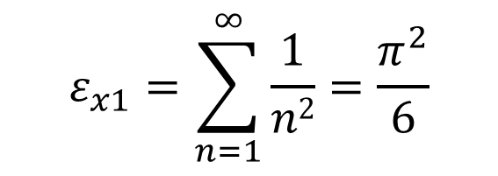
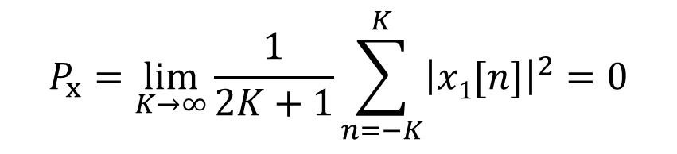
§2 Discrete-Time Signals In the Time-Domain
Energy signal: a finite energy signal with zero average power.
Example - Energy signal:
$$ε_{x1}=\sum_{n=1}^{∞}{\frac{1}{n2}}=\frac{π^{2}}{6}$$
$$P_{x}=\lim_{K→∞}{\frac{1}{2K+1}}\sum_{n=−K}^{K}{{\left|x1[n]\right|}^{2}=0}$$

Slide 11
4. Other Types of Classification
§2 Discrete-Time Signals In the Time-Domain
A sequence x[n] is said to be bounded if
Example - The sequence x[n]=cos(0.3πn) is a bounded sequence as

Slide 12
§2 Discrete-Time Signals In the Time-Domain
A sequence x[n] is said to be absolutely summable if
Example - The sequence
is an absolutely summable sequence as

Slide 13
§2 Discrete-Time Signals In the Time-Domain
A sequence x[n] is said to be square-summable if
Example - The sequence
is square-summable but not absolutely summable

Slide 14
§2 Discrete-Time Signals In the Time-Domain
Example - The sequence obtained by adding an absolutely summable sequence with its replicas shifted by integer multiples of N,
is called an N-periodic extension of .
It is neither absolutely summable nor square-summable .

Slide 15
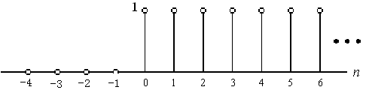
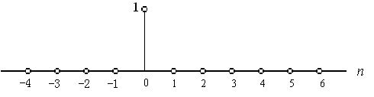
§ 2.4 Typical Sequences and Representation
2.4.1 Basic Sequences
Unit sample sequence
Unit step sequence
MOOC

Slide 16
2.4.3 Representation of an Arbitrary Sequence by impulses
§2 Discrete-Time Signals In the Time-Domain
An arbitrary sequence can be represented in the time-domain as a weighted sum of some basic sequence and its delayed (advanced) versions
MOOC

Slide 17
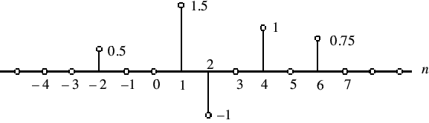
§2 Discrete-Time Signals In the Time-Domain
Example

Slide 18
§2 Discrete-Time Signals In the Time-Domain
Rectangular Window Sequence
Box-car sequence
Windowing

Slide 19

§2 Discrete-Time Signals In the Time-Domain
Sinusoidal Sequence
$$x[n]=A{cos(ω}_{0}{n}+φ),−∞<n<∞$$
where A is the amplitude, ω₀ is the normalized angular frequency, and φ is the phase of x[n].
The unit of ω₀ and φ is radians/sample
Often in practice, ω₀ is expressed as ω₀=2πf₀
Where f₀ is normalized frequency in cycles/sample

Slide 20

§2 Discrete-Time Signals In the Time-Domain
Sinusoidal Sequence
We can write as
is the in-phase components of x[n] and
is the quadrature components of x[n].
$$x[n]=A{cos(ω}_{0}{n}+φ),−∞<n<∞$$

Slide 21
Exponential Sequence
when A and are real or complex numbers.
The Complex Exponential Sequence
MOOC

Slide 22
Exponential Sequence
The complex sinusoidal sequence

Slide 23


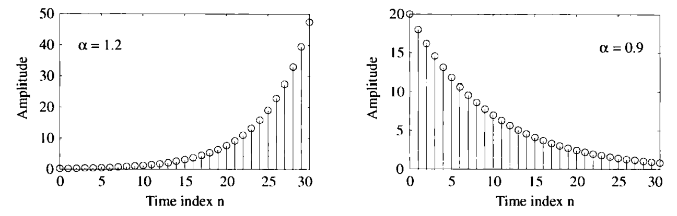
§2 Discrete-Time Signals In the Time-Domain
Real Exponential Sequence
when A and are real numbers, it’s a real exponential sequence.
MOOC

Slide 24

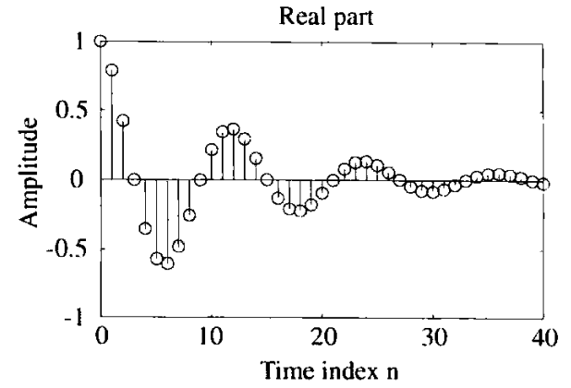
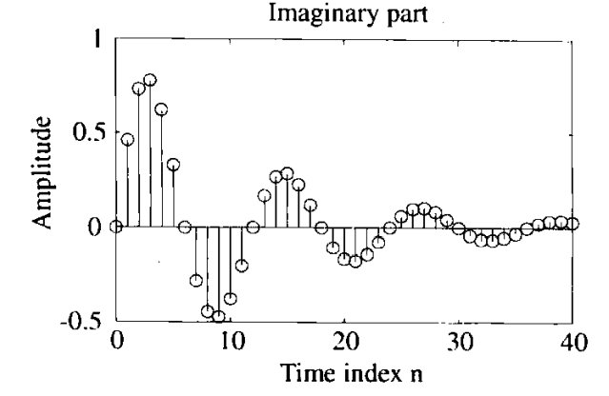
2.4.2 Sequence Generation Using MATLAB
n=0:40;
K=1;
c=(-1+j*2*pi)/12;
x=K*exp(c*n);
stem(n, real(x));
title('Real part');
stem(n, imag(x));
title('Imaginary part');

Slide 25
§2 Discrete-Time Signals In the Time-Domain
* The periodicity of sinusoidal and exponential sequence *
If 2π/ω₀ is an rational number,
the sequence x[n]=Acos(ω₀n+φ) is periodic.
Otherwise, it’s aperiodic.
Why?
How to determine the fundamental period?
MOOC

Slide 26

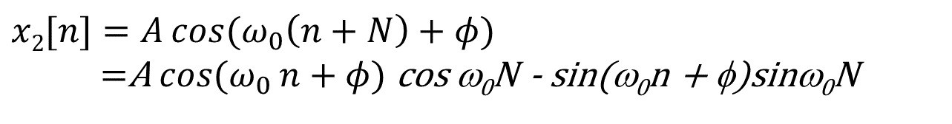
To verify the periodicity condition, consider
$$x1[n]=A{cos(ω}_{0}{n}+φ)$$
$x2[n]=A{cos⁡(ω}_{0}\left(n+N\right)+φ)$
=A${ cos⁡(ω}_{0}{n}+φ)$ cos ω₀N - sin(ω₀n + φ)sinω₀N
Only if sinω₀N= 0 and cosω₀N = 1,$x1[n]=x2[n]$
These two conditions are met if and only if
ω₀N = 2πr
or 2π / ω₀ = N/r
where N and r are positive integers.
Smallest value of N satisfying ω₀N=2πr
is the fundamental period of the sequence.
MOOC

Slide 27
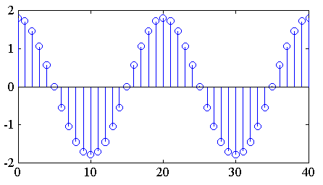
§2 Discrete-Time Signals In the Time-Domain
Example - x[n]=sin(3n) is an aperiodic sequence.
y[n]=cos(0.1πn) is a periodic sequence.
ω₀ = 0.1π
N= 2πr/ω₀
= 20 for r = 1
MOOC

Slide 28
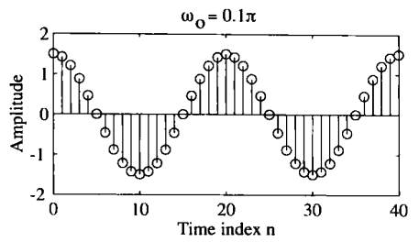
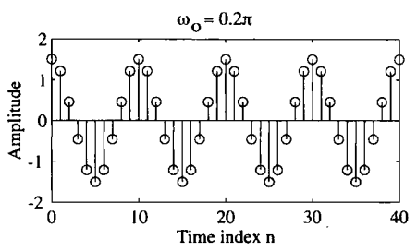
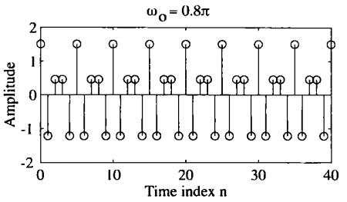
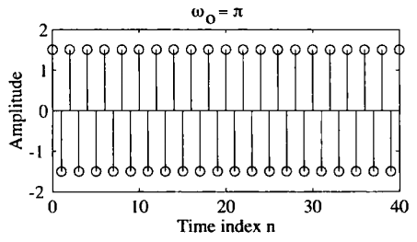
§2 Discrete-Time Signals In the Time-Domain
N= 2πr/ω₀
= 20, r=1
N= 2πr/ω₀
= 10, r=1
N= 2πr/ω₀
= 5, r=2
N= 2πr/ω₀
= 2, r=1

Slide 29
Two Properties of Sinusoidal Sequence
1. Consider: x₁[n]=Acos(ω₁n+φ), x₂[n]= Acos(ω₂n+φ)
Where, 0≤ ω₁<2π, and 2πk ≤ ω₂<2π(k+1)
k is an any positive integer.
If
ω₂ = ω₁+2πk
Then x₂[n] = Acos((ω₁+2πk) n+φ) = x₁[n]
ω₂ is equivalent to ω₁modulo 2π
(indistinguishable)
MOOC

Slide 30
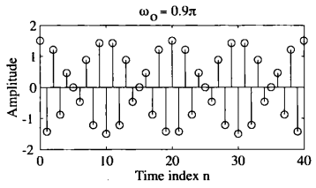
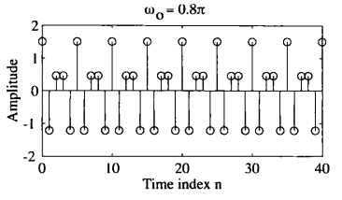
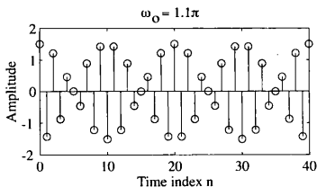
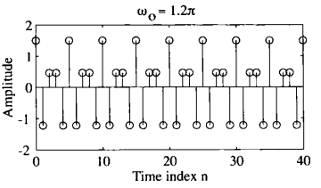
Two Properties of Sinusoidal Sequence
2.The highest ω of Sinusoidal Sequence is π.
folding frequency

Slide 31
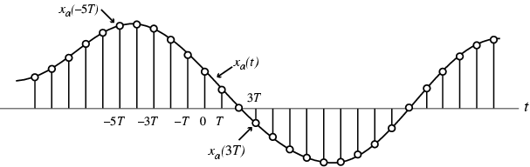
§2 Discrete-Time Signals In the Time-Domain
§ 2.5 The Sampling Process
Often, a discrete-time sequence x[n] is developed by uniformly sampling a continuous-time signal x_{a}(t) as indicated below
x[n]=x_{a}(t)|_{t=nT}=x_{a}(nT), n=…, -2, -1, 0, 1, 2, …

Slide 32
§2 Discrete-Time Signals In the Time-Domain
Time variable t of x_{a}(t) is related to the time variable n of x[n] only at discrete-time instants t_{n} given by
Here:
---sampling frequency
---sampling angular frequency
MOOC

Slide 33
§2 Discrete-Time Signals In the Time-Domain
Sampling a continuous-time Sinusoidal signal
The corresponding discrete-time signal is
where
is the normalized digital angular frequency of x[n]
MOOC
The unit of ω₀ is radians/sample

Slide 34
§2 Discrete-Time Signals In the Time-Domain
Note: The Ambiguity in the DT Representation of CT Signals
Example:
Three continuous-time signals
of frequencies 3 Hz, 7 Hz, and 13 Hz,
While sample distance T=0.1sec, the derived sequences are:
MOOC

Slide 35
§2 Discrete-Time Signals In the Time-Domain
Plots of these sequences (shown with circles) and their parent time functions:
1
0.5
Amplitude
0
-0.5
-1
0
0.2
0.4
0.6
0.8
1
time
Note that each sequence has exactly the same sample value for any given n
MOOC

Slide 36
§2 Discrete-Time Signals In the Time-Domain
This fact can also be verified by observing that
As a result, all three sequences are identical and it is difficult to associate a unique continuous-time function.
Why?

Slide 37
§2 Discrete-Time Signals In the Time-Domain
The above phenomenon of a continuous-time signal of higher frequency acquiring the identity of a sinusoidal sequence of lower frequency after sampling is called aliasing.
Recall: ω0 = 2πΩ0 / ΩT
Thus if Ω_{T} > 2Ω₀, then ω₀ of the discrete-time signal obtained by sampling the parent continuous-time sinusoidal signal will be in the range -π<ω<π.
No aliasing
If Ω_{T} < 2Ω₀ , the ω₀ will fold over into a lower digital frequency in the range
-π<ω<π because of aliasing.
Hence, to prevent aliasing, the sampling theorem requires Ω_{T} > 2Ω₀

Slide 38
Homework
2.3, 2.4(a) (b), 2.5, 2.9, 2.19, 2.21, 2.27, 2.28, 2.35(a)(b), 2.39, 2.47, 2.51;
M2.3, M2.4

